Slide 1
Computer Architecture
Atul Kahate

Slide 2
Distributed Systems

Slide 3
What is a Distributed System?
A distributed system is a collection of independent computers that appears to its users as a single coherent system.
In order to support heterogeneous computers and networks while offering a single-system view, distributed systems use middleware software logically placed between a higher-level layer consisting of users and applications, and a layer underneath consisting of operating systems and basic communication facilities
See figure on the next slide

Slide 4
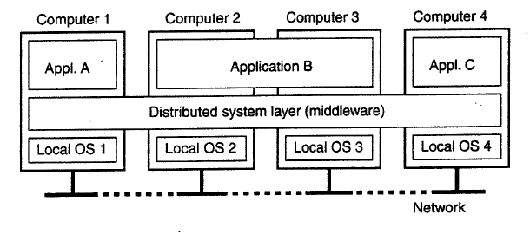
Distributed System using Middleware

Slide 5
Goals of a Distributed System
Making resources accessible
Distribution transparency (Types – Next slide)
Openness
Scalability

Slide 6
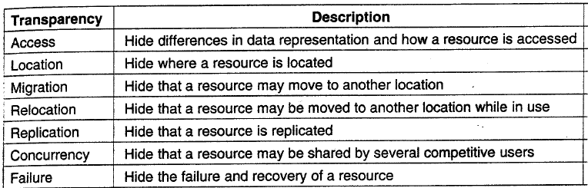
Types of Distribution Transparency

Slide 7
Cluster Computing

Slide 8
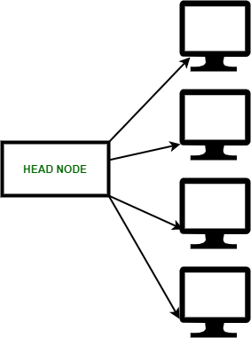
Cluster Computing
Cluster computing is a collection of tightly or loosely connected computers that work together so that they act as a single entity.
The connected computers execute operations all together thus creating the idea of a single system.
The clusters are generally connected through fast local area networks (LANs).

Slide 9
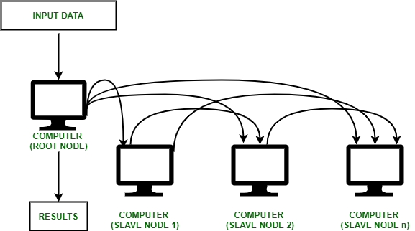
Cluster Computing Processing

Slide 10
Types of Cluster Computing
High Performance (HP) Clusters: HP clusters use computer clusters and supercomputers to solve advance computational problems. They are used to performing functions that need nodes to communicate as they perform their jobs. They are designed to take benefit of the parallel processing power of several nodes.
Load-balancing Clusters: Incoming requests are distributed for resources among several nodes running similar programs or having similar content. This prevents any single node from receiving a disproportionate amount of task. This type of distribution is generally used in a web-hosting environment.
High Availability (HA) Clusters: HA clusters are designed to maintain redundant nodes that can act as backup systems in case any failure occurs. Consistent computing services like business activities, complicated databases, customer services like e-websites and network file distribution are provided. They are designed to give uninterrupted data availability to the customers.

Slide 11
Grid Computing
Grid computing is a group of networked computers that work together as a virtual supercomputer to perform large tasks, such as analyzing huge sets of data or weather modeling.
By splitting tasks over multiple machines, processing time is significantly reduced to increase efficiency and minimize wasted resources.

Slide 12
Understanding the Differences
Parallel computing: All the computers share the same memory. These systems share their work and complete it together.
Grid computing: The computers are geographically distributed – they are not at one single place. A central processing unit controls the grid and gets computing power to deliver the task. The grid resources are heterogeneous.
Distributed computing: Similar to grid computing, but generally used for diverse tasks.
Cloud computing: On-demand availability of resources at a cheap price

Slide 13
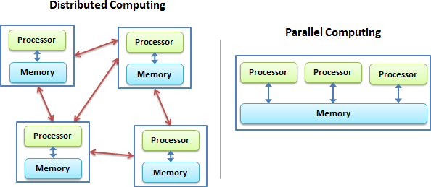
Distributed versus Parallel Computing

Slide 14
SMP, NUMA – Some Background
There are two types of parallel processing architectures
Shared Memory Architecture
In Shared Memory Architecture all processors share a common memory. This architecture is also called as Symmetric Multiprocessing (SMP). Cache Coherency is a challenge for this architecture and Snoopy scheme is a preferred way to handle it.
Shared Memory Architectures are of two types: Uniform Memory Access (UMA) and Non Uniform Memory Access (NUMA).
Distributed Memory Architecture

Slide 15
SMP
SMP (symmetric multiprocessing) is computer processing done by multiple processors that share a common operating system (OS) and memory.
In symmetric multiprocessing, the processors share the same input/output (I/O) bus or data path. A single copy of the OS is in charge of all the processors.
SMP systems are better suited for online transaction processing
SMP systems can dynamically balance the workload among computers to serve more users faster.
The SMP computer architecture is a multiprocessor hardware and software architecture that has multiple identical processors.
The processors equally share main memory and have access to all I/O devices.
Today, most modern OSes support SMP machines. In the past, users had to learn special programming skills to use SMP.

Slide 16
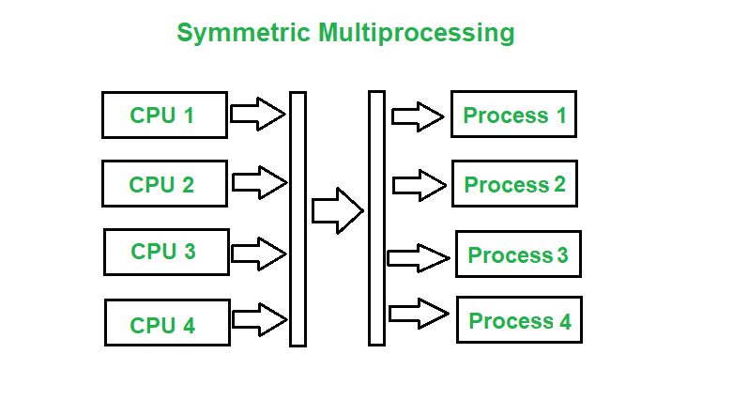
SMP

Slide 17
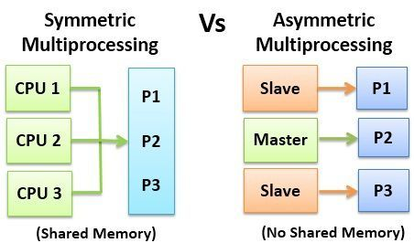
Symmetric versus Asymmetric Multiprocessing

Slide 18
NUMA
Non-uniform Memory Access (NUMA) is a multiprocessor model in which each processor is connected with the dedicated memory.
NUMA machines were intended to prevent the memory access bottleneck of UMA machines.
The logically shared memory is physically assigned among the processing nodes of NUMA machines, leading to distributed shared memory architectures.
These parallel computers became hugely scalable, but they are very responsive to data allocation in local memories. Accessing a local memory segment of a node is much quicker than accessing a remote memory segment.
The main difference is in the organization of the address space. In multiprocessors, a global address space is used that is consistently visible from each processor. Several processors can access all memory areas.

Slide 19
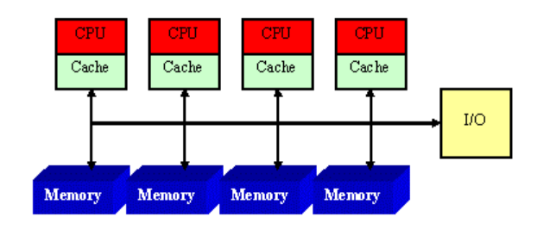
UMA

Slide 20
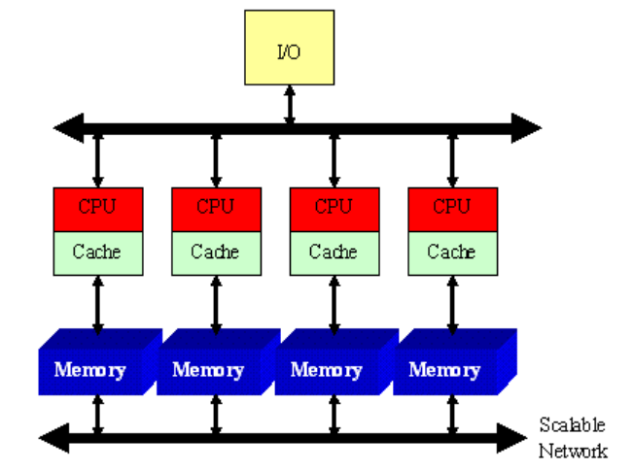
NUMA

